Slide 1

OOPS CONCEPT

Slide 2

OOPS-(Object Oriented Programming System)
1.OOPS is a methodology or paradigm to design a program using classes and objects.
2.It simplifies the software development and maintenance.
Object
Class
Inheritance
Polymorphism
Abstraction
Encapsulation

Slide 3
Object
An entity that has state and behavior is known as an object. An object is an instance of class. e.g. chair, bike, marker, pen, table, car etc.
Class
A class is a group of object which have common properties.

Slide 4
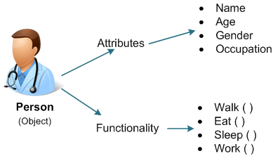
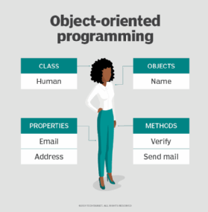
Examples of OOPS:

Slide 5
INHERITANCE
It is a mechanism in which one object acquires all the properties and behaviors of a parent object.
Properties of acquiring base class from child class.
There are 5 types of Inheritance in java
1.Single level Inheritance.
2.Multi level Inheritance.
3.Hierarchical Inheritance.
4.Multiple Inheritance.
5.Hybrid Inheritance.

Slide 6
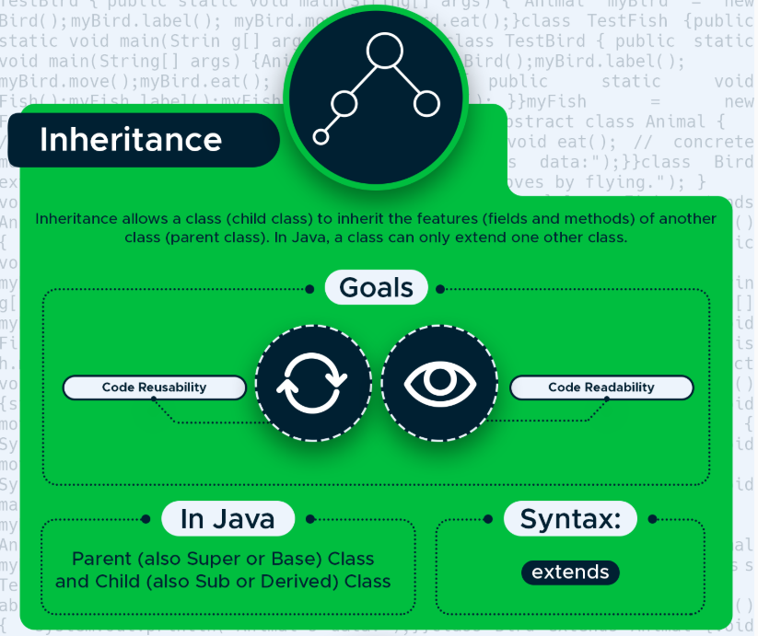
Inheritance Example:

Slide 7
POLYMORPHISM
It is a concept by which we can perform a single action in different ways. We can perform polymorphism in java by method overloading and method overriding.
There are two types of Polymorphism
1.Compile time polymorphism
2.Run time polymorphism

Slide 8
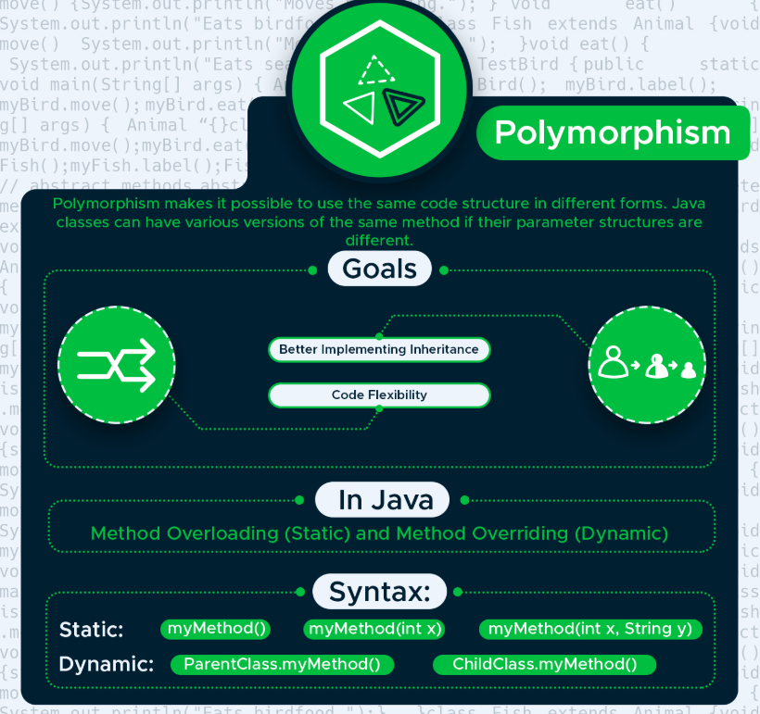
Polymorphism example:

Slide 9
Compile time polymorphism:
Compile time polymorphism or static method dispatch is a process in which a call to an overloading method is resolved at compile time.
Run time polymorphism:
Runtime polymorphism or Dynamic Method Dispatch is a process in which a call to an overridden method is resolved at runtime

Slide 10
Method Overloading:
If a class has multiple methods having same name but different in parameters, it is known as Method Overloading.
Method Overriding:
If a class has multiple methods having same name but different in parameters, it is known as Method Overloading.

Slide 11
Abstraction:
Data Abstraction is the property by virtue of which only the essential details are displayed to the user. The trivial or the non-essentials units are not displayed to the user.
The “abstract” keyword is a non-access modifier, used for classes and methods.

Slide 12
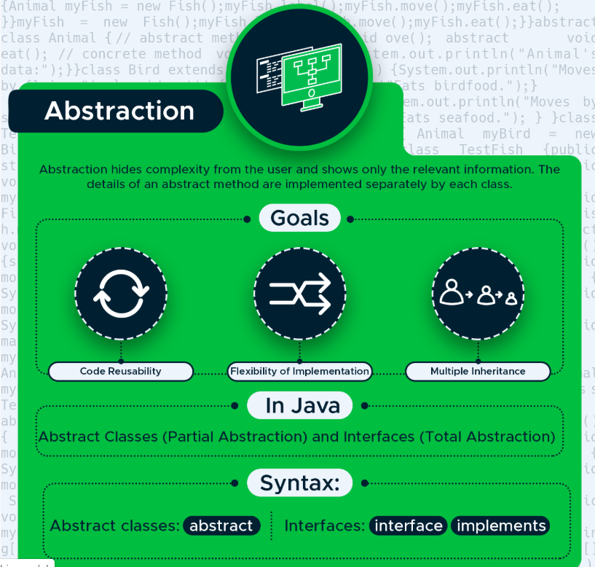
Abstraction example:

Slide 13
Abstract class & methods
Abstract class: is a restricted class that cannot be used to create objects (to access it, it must be inherited from another class).
abstract class Student { // abstract class
}
Abstract method: can only be used in an abstract class, and it does not have a body. The body is provided by the subclass (inherited from).
Syntax:
abstract datatype function_name(argument);

Slide 14
Interface:
An interface in Java is a blueprint of a class. It has static constants and abstract methods.
The interface in Java is a mechanism to achieve abstraction. There can be only abstract methods in the Java interface, not method body. It is used to achieve abstraction and multiple inheritance in Java.
In other words, you can say that interfaces can have abstract methods and variables. It cannot have a method body.
Java Interface also represents the IS-A relationship.
It cannot be instantiated just like the abstract class.
Since Java 8, we can have default and static methods in an interface.
Since Java 9, we can have private methods in an interface.

Slide 15
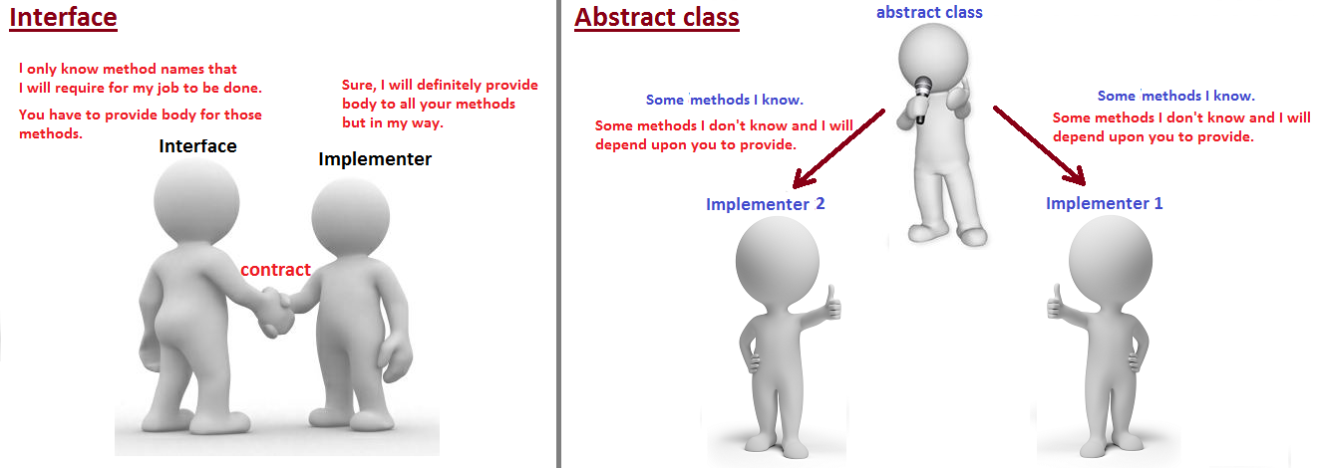
Interface example:

Slide 16
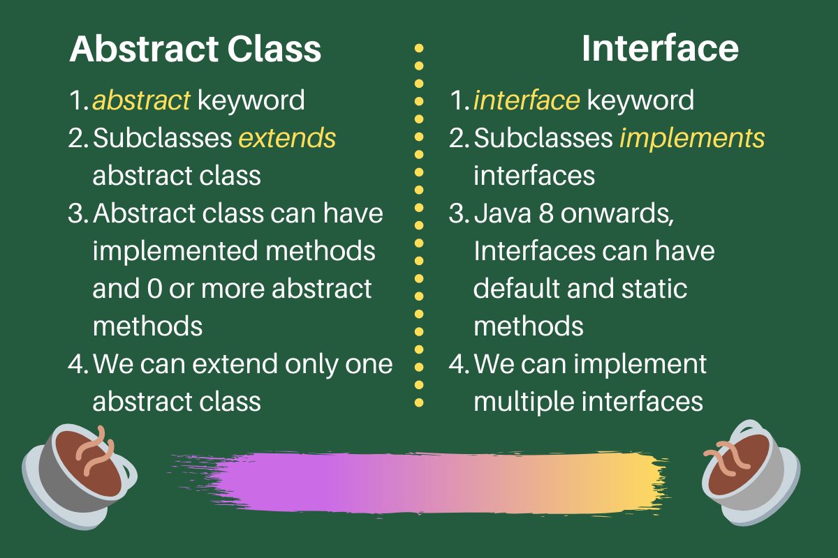
Difference between abstraction & interface :

